Slide 1
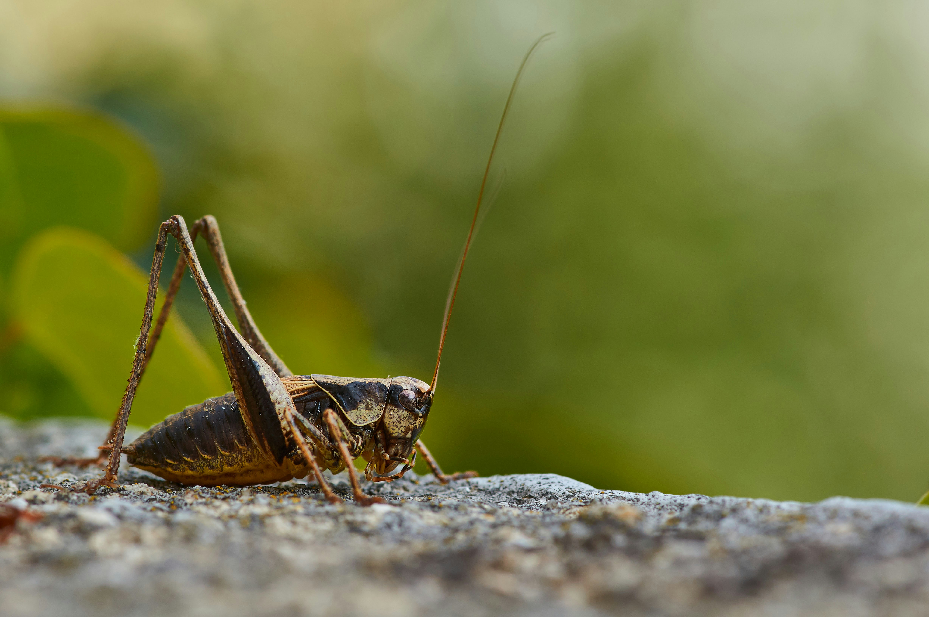

SPECIES IDENTIFICATION OF CICADAS AND ORTHOPTERAN THROUGH CNN BASED SOUND CLASSIFICATION
Student ID : 1089046 Thesis Supervisor : Dr. Akash Talwariya Liverpool Jhon Moores University & UpGrad Master of Science in Data Science April 2024

Slide 2
INTRODUCTION
In the Netherlands, insects make up approximately 40% of total biodiversity, whereas mammals and plants constitute only 5% and 8%.
The unique sounds of various insect groups offer potential for revolutionizing species identification and expediting biodiversity monitoring.
Noises emitted by certain species aid in their rapid identification, particularly when visual observation is challenging due to factors such as size, camouflage, activity, or environment.
For our study, we are examining species from two orders: Hemiptera, which includes cicadas, and Orthoptera, which encompasses grasshoppers, crickets, and katydids.
To identify Orthoptera based on their sounds, research has predominantly depended on manually extracting sound parameters such as carrier frequency and pulse rates
Orthoptera are poikilothermic species, the ambient temperature during the recording may have an impact on how frequently they sing.

Slide 3
AIM
Develop and Evaluate an effective insect audio classification using CNN

Slide 4
OBJECTIVES
To analyze the data augmentation and pre-process technique helps to handle data imbalance.
To investigate the potential of transfer learning by fine-tuning a pre-trained CNN ​
To analyze the learned features within the pre-trained CNN to gain insights into what audio characteristics contribute to accurate classification​
RESEARCH QUESTIONS
Can deep learning techniques be employed to assess the capacity of various models in recognizing acoustic scenes associated with insects?
Can data augmentation technique help to handle data imbalance?

Slide 5
LITERATURE REVIEW
Learnable Frontend: (Koops et al., 2015; Ravanelli & Bengio, 2019; Sainath et al., 2015)
Mel Frontend: (Chi et al., 2019; He et al., 2016; Noda et al., 2019; Xu et al., 2019)
Augmentation: (Park et al., 2019)
Review: (Howard et al., 2017; Huang et al., 2017; Mesaros et al., 2016; Montgomery et al., 2019; Riede, 2018; Seki et al., 2017; Szegedy et al., 2014; Tan et al., 2018)
Learnable Frontend : (Anderson et al., 2023; Branding et al., 2023; Faiß & Stowell, 2023; Ribeiro et al., 2023)
Mel Frontend : (Bilal et al., 2023; Lemm, 2024; Lostanlen et al., 2023; Yin et al., 2023; Zhang et al., 2023)
Data Augmentation : (Chu et al., 2023)
Learnable Frontend: (Yadav, 2021; Zeghidour et al., 2021)
Mel Frontend: (Siddhartha Varma et al., 2021)
Review: (Heller et al., 2021)
Till 2019
2020
2021
2022
2023+
Mel Frontend: (Mushtaq & Su, 2020; Xiang et al., 2020)
Augmentation: (Freer et al., 2020; Zhu et al., 2020)
Review: (Song et al., 2020; Wagner, 2020)
Learnable Frontend: (Anderson & Harte, 2022; Schlüter & Gutenbrunner , 2022)
Mel Frontend: (Cicada et al., 2022; Li et al., 2022)
Review: (Stowell, 2022)

Slide 6
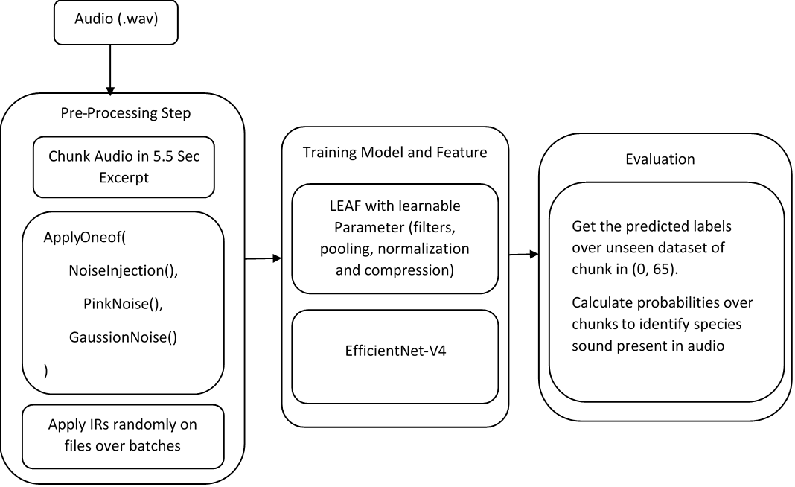
METHODOLOGY
EfficientNet-V2

Slide 7
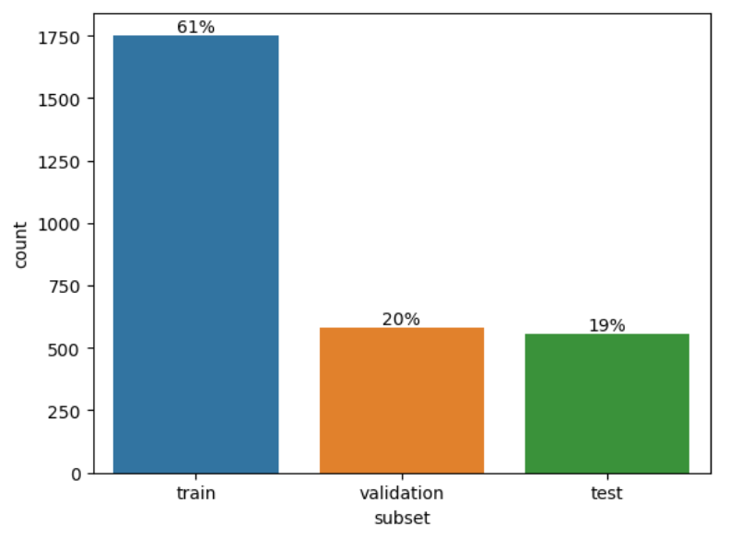
DATA COLLECTION
Two types of auditory family were employed, including orthopterans and cicada.
Data is collecting from BioAcoustica, xeno-canto, iNaturalist, and private collections curated by Baudewijn Odé was undertaken.
Dataset include noise interference, extensive filtering artifacts, or included sounds from multiple species.
Dataset are in 44.1 kHz mono WAV format, with durations spanning from less than one second to several minutes.
We have total of 2887 recordings representing these 66 species.
Dataset distribution for train, validation and test

Slide 8
ALGORITHM & TECHNIQUE
Model Building and Evaluation
Data Processing
Feature Extraction
5.5 Sec Chunk
Mel - Spectrogram
EfficientV2
During
Noise , Pink , Gaussian Injection
LEAF
IR’s Injection
Efficient LEAF
SpecAug ( Time & Frequency Masking) MixUp
Accuracy ( each species files ) ,
Macro- Average ( Precision, Recall, F1-Score)

Slide 9
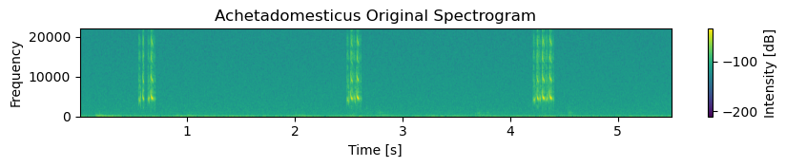
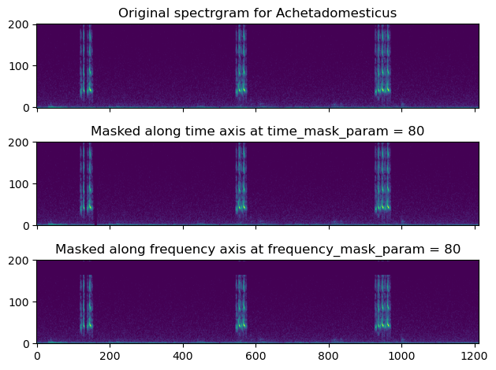
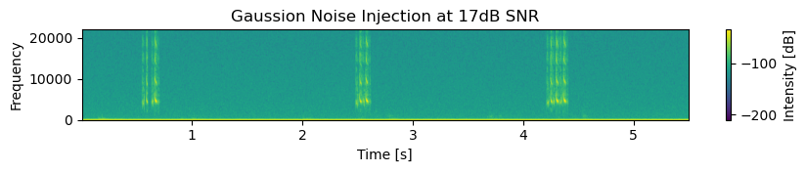
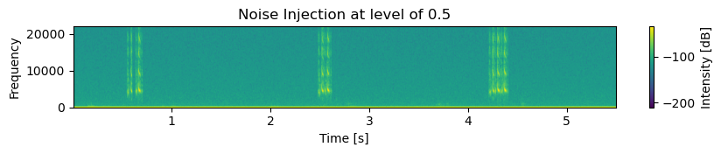
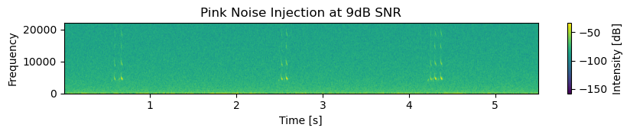
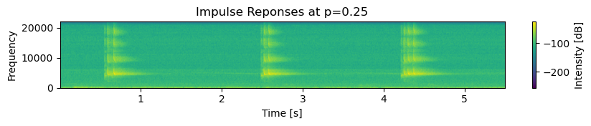
DATA PROCESSING
(a)
(b)
(c)
(d)
(e)

Slide 10




Fronted Differences
MEL- FILTERBANK
STFT
$${| |}^{2}$$
MEL
LOG
LEAF
GABOR
$${| |}^{2}$$
GAUSSION LOWPASS
sPCEN
EFFICIENT LEAF
GROUPED GABOR
$${| |}^{2}$$
TEMPORAL POOLING
LOGTBN
Breakdown of computation of mel-filterbank, LEAF , EfficientLEAF. Orange boxes are fixed. While computation in blue boxes are learnable. Grey boxes represent activation functions.
Note :
sPCEN = Smoothing Coefficient Per Channel Energy Normalization
LOGTBN = Log1p (each frequency band ) + Subtract Median filter + TBN (temporal batch normalization) compression function

Slide 11

FEATURE EXTRACTION
LEAF
A frontend of LEAF (Yadav, 2021) with hyperparameter
n_filters =60
Min_freq = 300
Batch Size = 16
Leaf Hop = 3.335
Initializer = Mel
compression= Per Channel Energy Normalization
Mel – Spectrogram
A frontend Mel-Spectrogram (Lemm, 2024) with parameter used in GDSC5 (Global Data Science Challenge by Capgemini) with hyperparameters.
n_fft = 2048
Min_freq = 300
Batch Size = 64
Mel Normalization = True
Sample rate = 44100
Efficient LEAF
A frontend of EfficientLEAF (Schlüter and Gutenbrunner, 2022) with hyperparameter
n_filters =40
Min_freq = 300
Batch Size = 32
Initializer = Mel
tbn_median_filter= True
compression = LOGTBN
n_gabor_filters = 8

Slide 12

MODEL SETUP
Training
AdamW (lr = 0.0017, wd = 1e-5)
CrossEntropyLoss
Inverse class weights
Label smoothing = 0.1
CosineAnnealing (1e-9)
16,32,64 batches used
EfficientNet –V2 PyTorch
Build for performance and efficiency
Pre-trained models (ImageNet 21k) allow for fast transfer learning
Optimized on accuracy, parameter and training efficiency
Progressive Learning with Adaptive Regularization
Used by baseline model of leaf Zeghidour et al., 2021 an achieved good accuracy over various datasets.
Since 2021, EfficientnetV2-S is always among the top architectures in bird song recognition challenges on Kaggle
Evaluation
Prediction of all chunks per sound file
Accuracy , Macro Averging (Precison , Recall ,F1-Score)

Slide 13
RESULTS TABLES
Model |  | Over Each Species Audio | Macro- Averaging
 | Batch Size | Accuracy | Precision | Recall | F1-Score
Baseline Mel Spectrogram + EfficientNetV4 | 64 | 0.91 | 0.92 | 0.89 | 0.89
Baseline LEAF + CNN Conv2D Model |  | 0.83 | 0.81 | 0.77 | 0.76
Leaf (40 filters) + EfficientNet-v2 (pre-trained) | 16 | 0.82 | 0.84 | 0.77 | 0.78
EfficientLEAF (40 filters) + EfficientNet-v2 (pre-trained) | 32 | 0.92 | 0.89 | 0.88 | 0.87

Slide 14
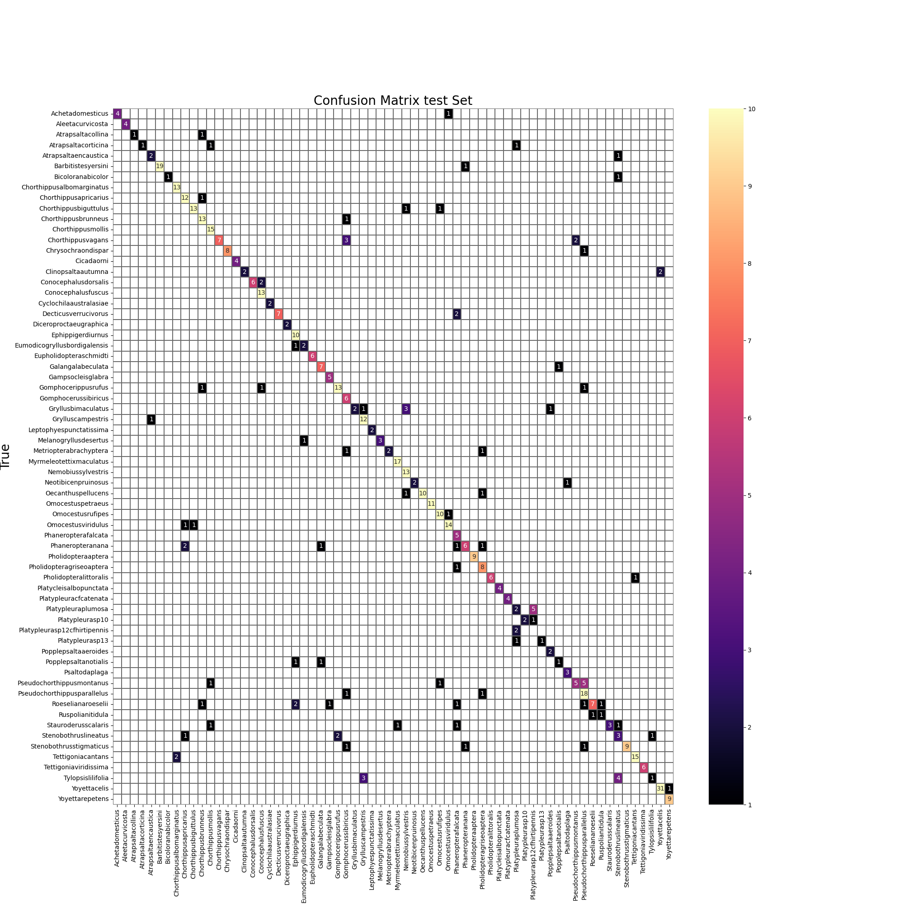
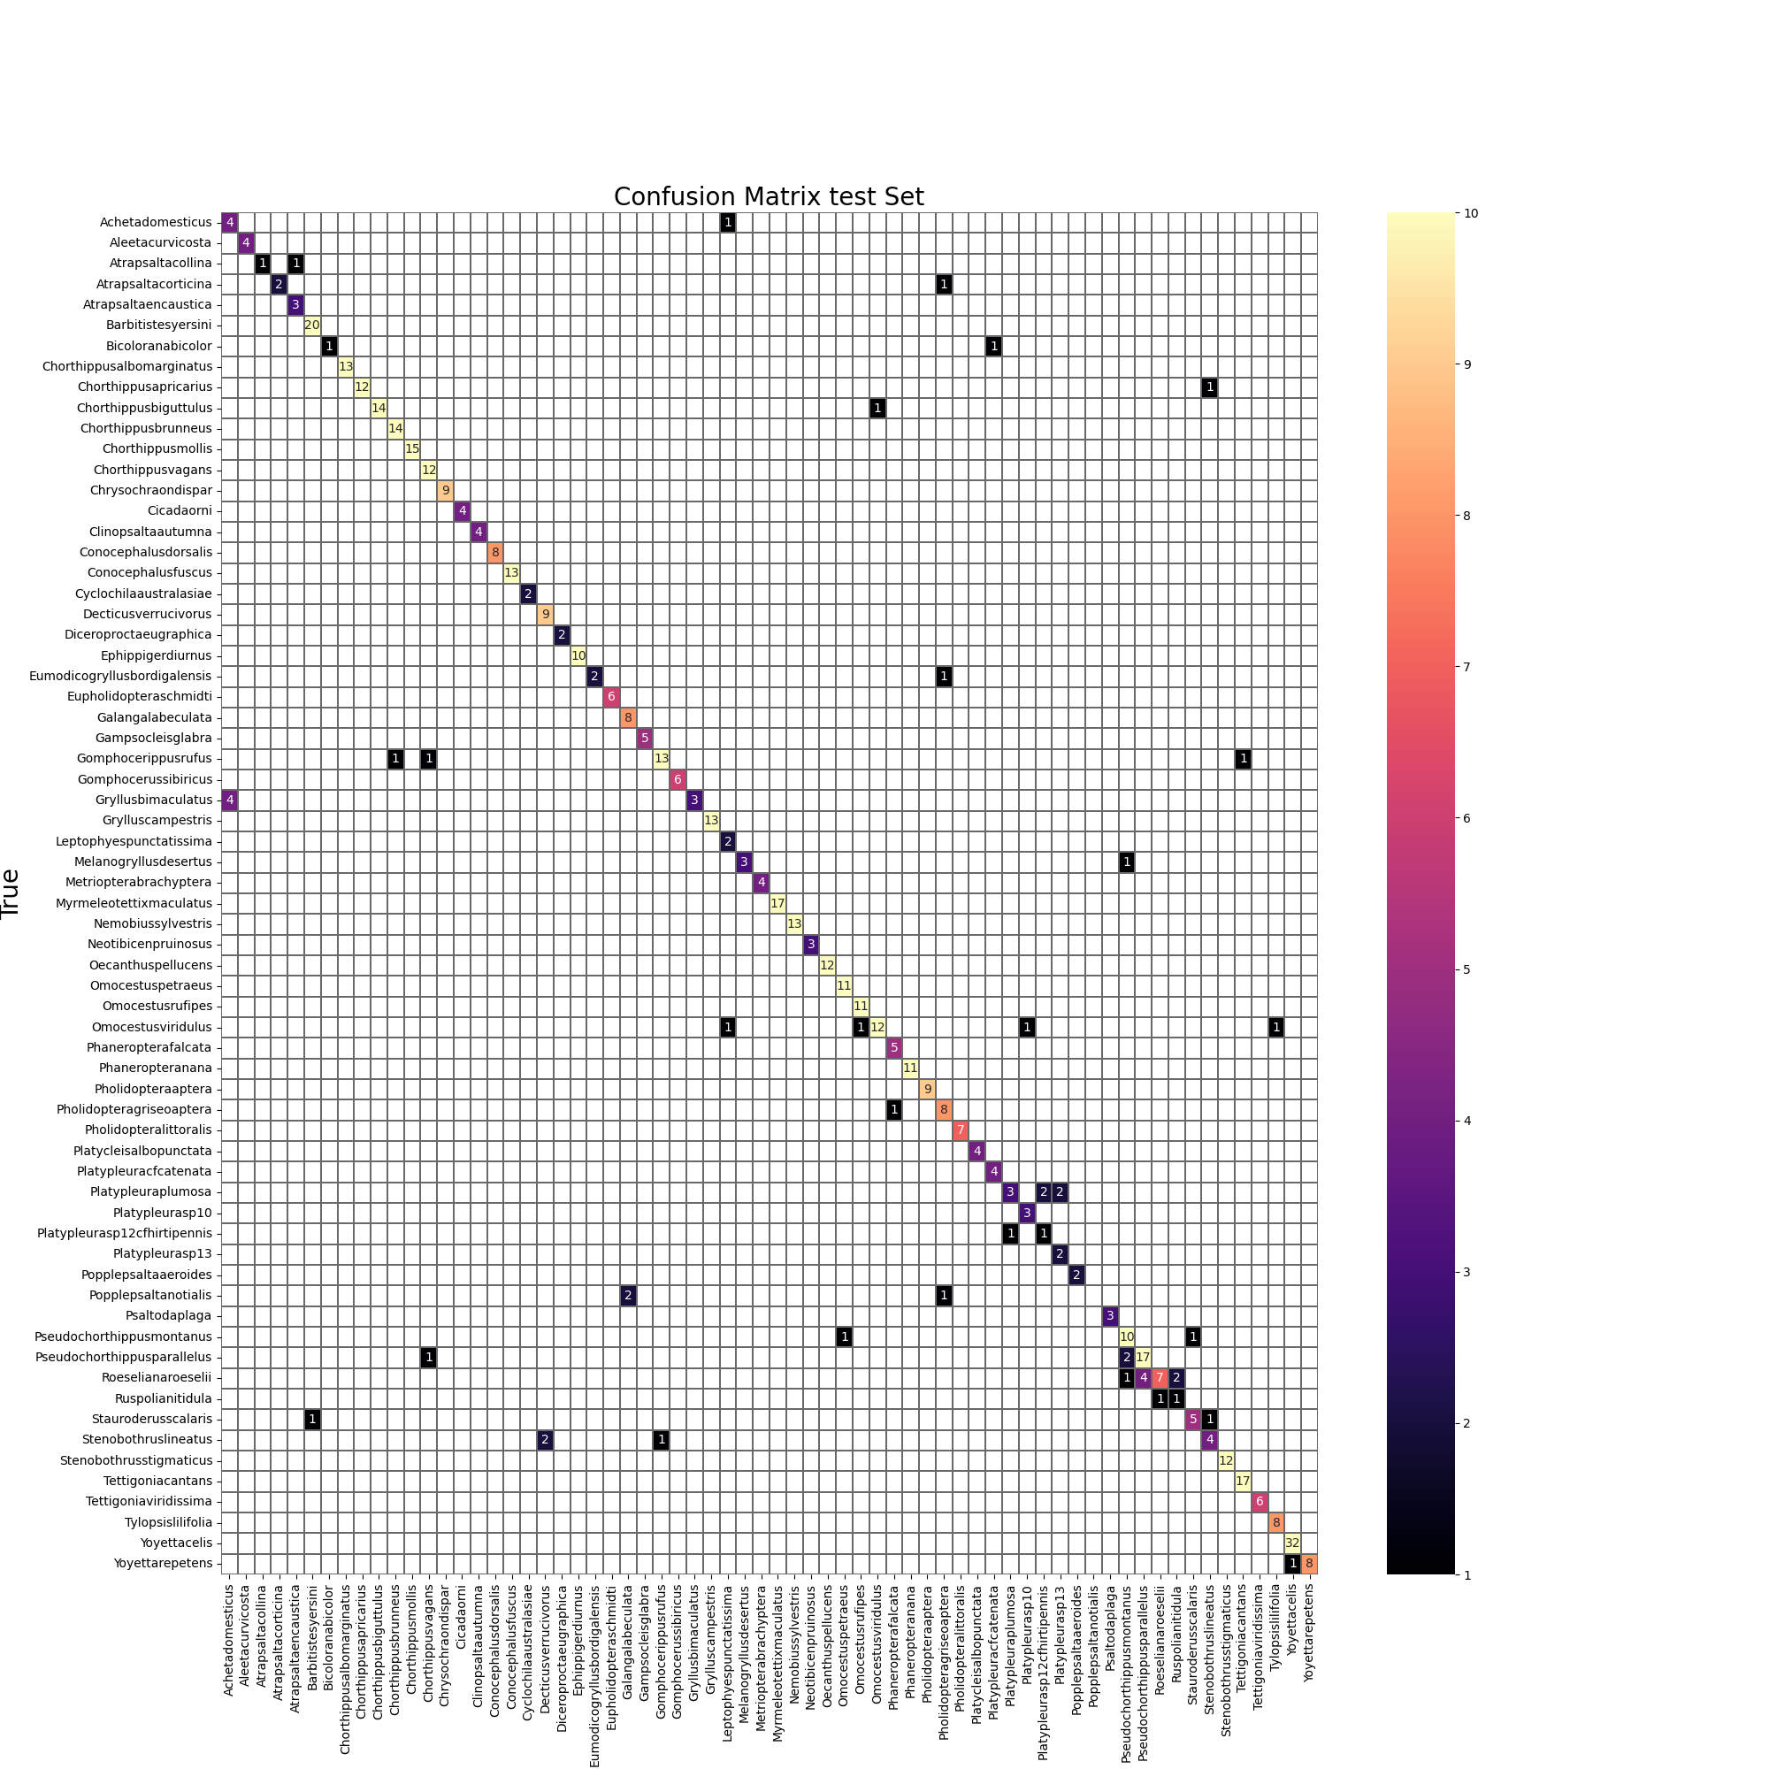
CONFUSION MATRIX OF EACH SPECIES OVER LEAF & EFFICENTLEAF
LEAF
EFFICIENTLEAF

Slide 15

CONFUSION MATRIX OF EACH SPECIES OVER MEL & EFFICENTLEAF
MEL-SPECTROGRAM
EFFICIENTLEAF

Slide 16
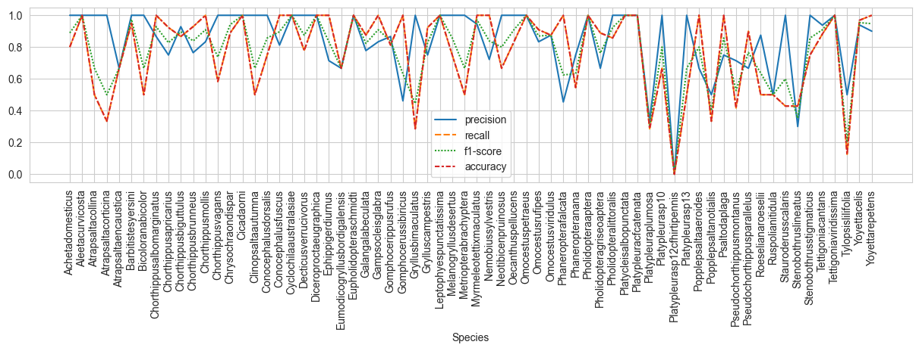
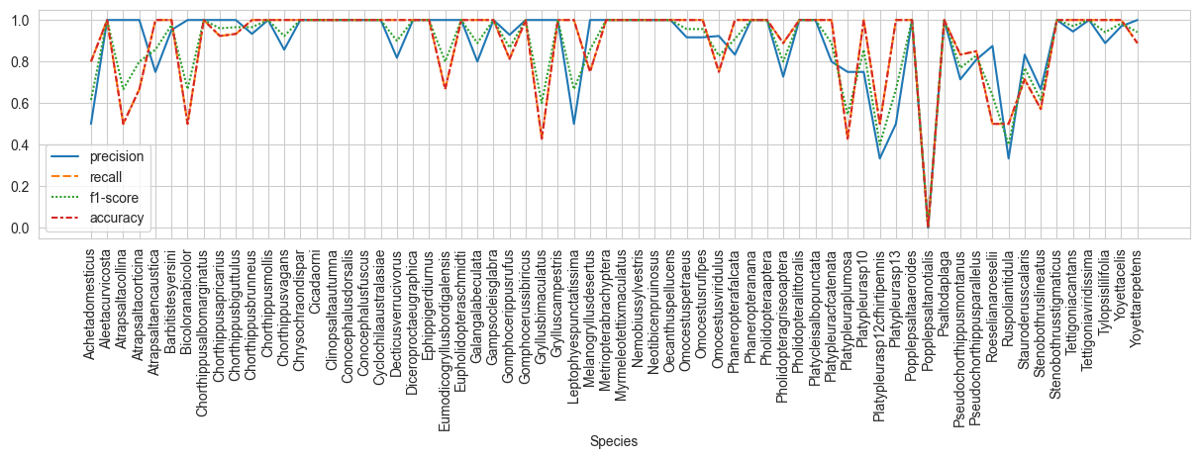
EVALUATION PLOT OF EACH SPECIES OVER LEAF & EFFICENTLEAF
LEAF
EFFICIENTLEAF

Slide 17
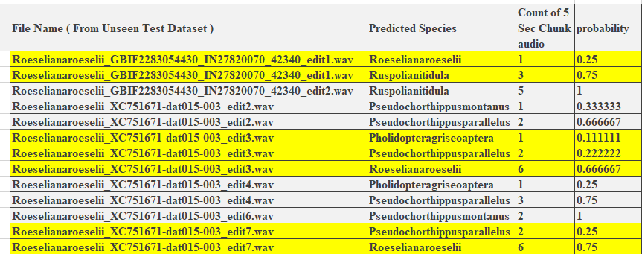
PREDICTION OVER 5SEC CHUNCK OF DATA
Table displays the probability of predicted species over 7 misclassified audio clips of Roeselianaroeselii over EfficientLEAF.

Slide 18
Efficient LEAF has surpassed both LEAF and Mel-spectrogram models in performance.
Implementing data augmentation techniques, whether applied directly to raw waveforms or during training, proved instrumental in achieving high prediction scores.
Training Efficient LEAF on a batch size of 64 can improve species classification accuracy.
Larger batch sizes require more GPU memory for model training.
These experiments, conducted over 100 epochs, have demonstrated the potential for achieving superior scores on these models trained specifically for each species.
CONCLUSION

Slide 19
FUTURE RECOMMENDATION
While the model sizes across all experiments hover around 220MB, exploring techniques such as pruning and quantization can significantly reduce these sizes.
Showcasing the capabilities of these models through web applications.
Testing EfficientLeaf over 64 batch size could improve accuracy over test datasets.

Slide 20




